Slide 1

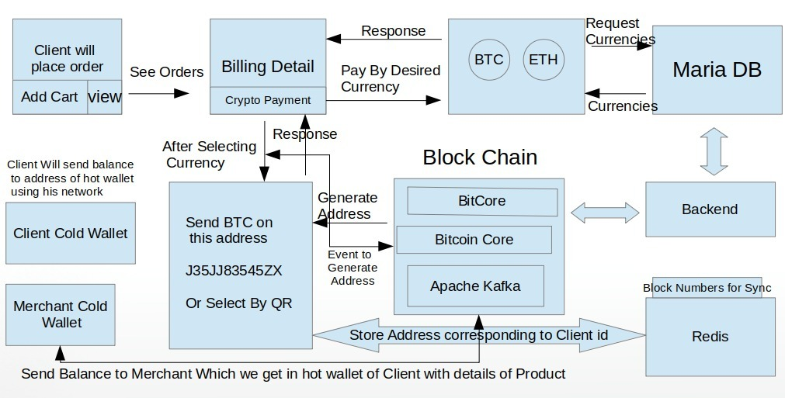
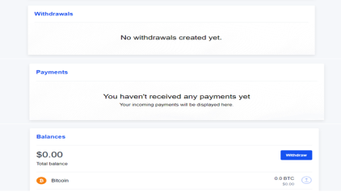

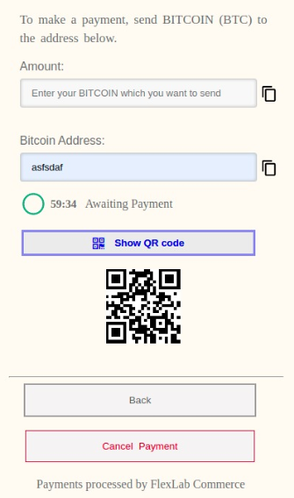


^{Crypto Payment Gateway} ^{Final Year Project (2016-2020)} ^{Department of Computer Science} COMSATS University Islamabad, Attock Campus
Introduction
Our payment gateway helps the customer to pay in cryptocurrency, the payment will be directly transferred to the merchant without sharing the customer's information. The system will be blockchain based which will ensure that one entity will not be able to control or manipulate the system. When a buyer comes to merchant website and wants to pay in bitcoin we will show him an address. Buyer will send amount in the provided address.
Motivations
Increase the sales of merchant with borderless payments.
Low Transaction Fees.
Security because of blockchain network. The transaction cannot be modified or deleted so the chances of fraud are reduced to a great extent.
No chargebacks on payments
No third parties between merchant and customer.
System Background
There are some problems with the existing systems which are identified below:
Slow transaction speed and confirmation.
High transaction cost in existing system.
Market liquidity and convertibility.
Blockchain Specific Issues.
Architecture
Results
Merchant dashboard
Merchant can manage his account balance, received payments and withdrawals on dashboard.
Conclusion
This crypto payment gateway enables merchant to receive bitcoins on their stores. By enabling crypto currency they can get clients from multiple countries because crypto payments are borderless payments. Furthermore this is the most safest form of transaction because blockchain network is verifying and cofirmining the transaction.
Future Directions
As the use of bitcoin and other virtual currencies is increasing day by day, we will also enhance our crypto payment gateway by providing support for other virtual currencies like Ethereum, Litecoin, Bitcoin Cash and Dai etc.
We will also provide additional functionalities like donating amount in crypto currencies.
User Application
Buyer get the amount and address.
Objectives
Group Members
Haider Yaqoob
haideryaqoobengr@gmail.com
Aamir Mushtaq
aamirmushtaq.inn@gmail.com
Supervisor: Co-Supervisor:
Dr. Chaudary Shahzad Faisal Dr. Khalid Mehmood
Providing an interactive user experience.
Getting customers’ loyalty and attraction.
Customer can easily pay in bitcoin.
Merchant can receive all the transactions happen on his store.
Merchant can withdraw his balance from his payment gateway dashboard.

